Slide 1

Simplifying SQL Server & SharePoint Migrations using PowerShell
Chrissy LeMaire, PowerShell MVP Ron Crisswell
Track: IT PRO | Level: 000

Slide 3

Chrissy LeMaire
PowerShell MVP
SQL DBA with GDIT at NATO Spec Ops HQ
Worked with SharePoint since 2007
@cl on Twitter

Slide 4

Ronald Crisswell
SharePoint Administrator with General Dynamics IT at NATO Spec Ops HQ
Working with SharePoint and related services for over 10 years. Since before SharePoint 2007 and BPOS

Slide 5
Agenda
Why
What
Considerations
Migration Methods
Demo
Summary

Slide 6
Why Migrate?

Slide 7


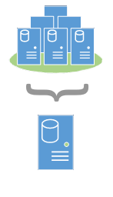

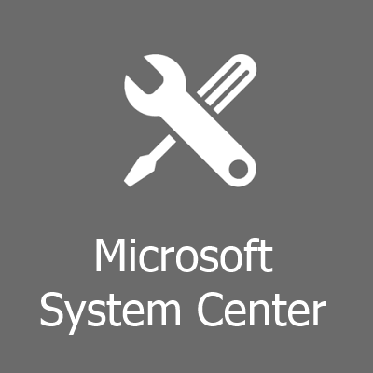
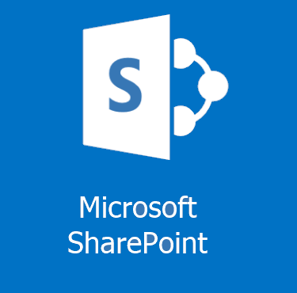
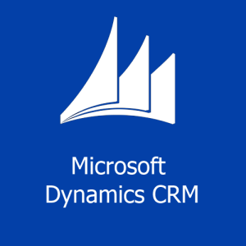
SQL Server Migrations
Misconfigured SQL Servers
Change in HA Strategy
Consolidation
Resource Requirements /
Best Practices
Platform Changes
SQL Server, OS, hardware, virtualization, Azure

Slide 8
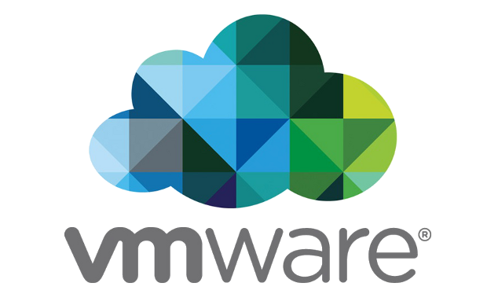

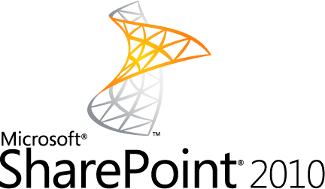
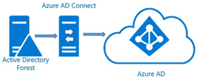

SharePoint Migrations
Virtualization
Consolidation
Legacy Deployments
Hybrid

Slide 9
What to Migrate?

Slide 10
SQL Server Migrations
Databases
Logins
Jobs & Schedules
Server Configurations
Linked Servers
Credentials
Reporting Services
Integration Services
Maintenance objects
Availability Groups
Replication Settings
Central Management Server
Agent Operators
Agent Alerts
Proxies
Certificates
Policy Management
Resource Pools

Slide 11
SQL Server Migrations
Databases
Logins
Jobs & Schedules
Server Configurations
Maintenance objects
Availability Groups
Agent Operators
Agent Alerts

Slide 12
SharePoint Migrations
Configuration Values
Content Databases
Config Databases
Custom Solutions – css, web.config tweaks, site templates, metadata deployments, etc.
3rd Party Products – Metalogix, Gimmal, Bamboo, DocAve, etc.
Scheduled Tasks – Stored and scheduled PowerShell scripts

Slide 13
Considerations

Slide 14
SQL Server Migration Considerations
Databases
Logins
Complex file structures, filestreams, full-text indexes, edition differences, version compatibility settings, server collation, mirroring, broker-enabled, trustworthy, read-only, owner Availability Groups, replication, associated logins, jobs, linked servers, post migration actions, reattach at source, set source read only, database state, log shipping, currently connected users, is system db, exists at destination,, owner chaining, associated logins, jobs, certificates, packages, etc.
SIDs, passwords, server roles,
server permission sets, credential mapping, password complexity & expiration, default db, owned databases, status, default language,
exists at destination, login type, destination login mode, version/hash compatibility, related objects like jobs, can’t drop if schema owner or assigned a permission set, does windows login exist at destination,

Slide 15
SharePoint Migration Considerations
The Service application shuffle – 2007, 2010, 2013, 2016, Oh my!
Moving into the Clouds . . . and avoiding the lightning
Custom Solutions – GUIDS and why you'll hate them
3rd Party Migration Tool$

Slide 16
Migration Methods

Slide 17
SQL Server Migrations
Backup and restore - well-suited for many situations - solid and straightforward - labor intensive, but scriptable
Detach, copy, attach - solid, but labor intensive - drops some attributes - increased downtime
Import Export Data Wizard - slow - can be messy & error prone - loses attributes and logins
Log Shipping - ideal for large databases - solid, but more complex - edition/version combo issues
Mirroring - ideal for large databases - complex - edition dependent
Copy Database Wizard - decent for small migrations - prone to errors - drops some attributes - dependencies often error out

Slide 18
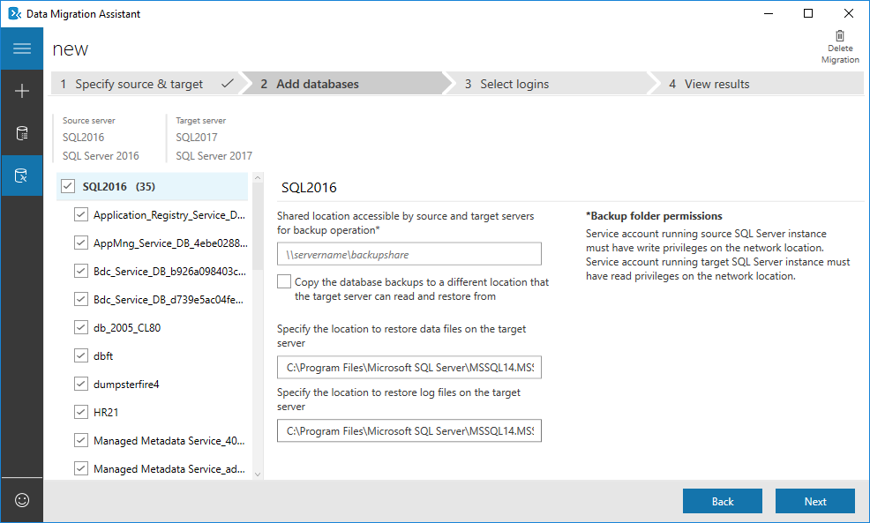
SQL Server Migrations
Data Migration Assistant
Notes:
It avoids the dependency errors by not even attempting to migrate them ;)

Slide 19
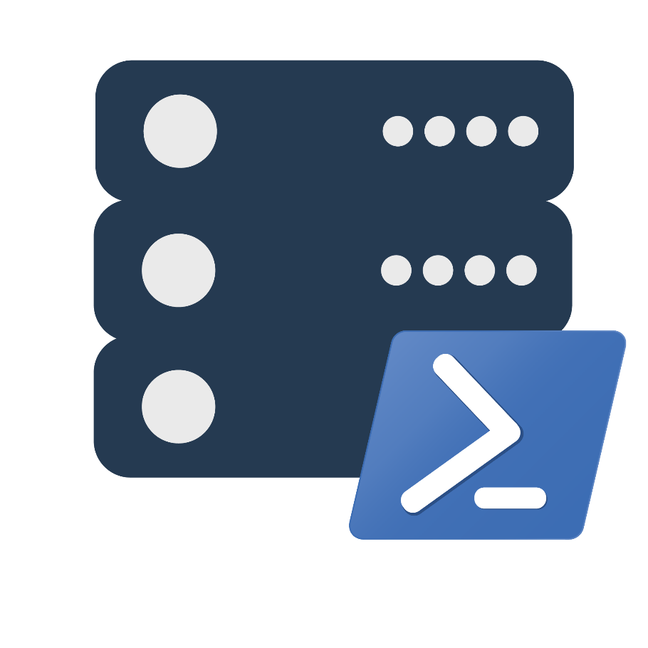
SQL Server Migrations
dbatools / PowerShell

Slide 20
SQL Server Migrations
Copy-DbaDatabase
Copy-DbaLogin
Copy-DbaSqlServerAgent
Copy-DbaSpConfigure
- or –
Start-DbaMigration

Slide 21
Native SharePoint-Only Migrations
Backup and Restore
Backup-SPSite / Restore-SPSite
Backup-SPFarm / Restore-SPFarm
Backup – SPConfigurationDatabase
Thread Based Selection
- Storage Intensive
Import Export
Export-SPWeb / Import-SPWeb
Limited Scope – Site, List, or Library
Object Model Transfer
Utilize API to migrate objects from sites, site collections, lists, and libraries.
Cloud friendly, bandwidth intensive
3rd Party Migration Tool$
AvePoint, Dell, Metalogix, Axceler, etc.
Big $ $ $,

Slide 22
SharePoint & SQL Server Database Migrations
Aliasing Entire SQL Server Instance
Start-DbaMigration
Point to all new instance
New-DbaClientAlias
Migrating Specific Content Databases
Copy-DbaDatabase
Copy-DbaLogin
Attaching Specific Content Databases
Mount-SPContentDatabase

Slide 23
SQL Server SharePoint Database Migrations
SQL Server: Set Content Database on source to read-only
Set-DbaDatabaseState
SQL Server: Copy the Content Database and associated SQL Server login
Copy-DbaDatabase
Copy-DbaLogin
SQL Server: Set Content Database on destination to read-write
Set-DbaDatabaseState
SharePoint Server: Create Web Application
New-SPWebApplication
SharePoint Server: Mount Content Database
Mount-SPContentDatabase
The Microsoft Minute: "This Won't Take Long"
Update DNS Records

Slide 24
Demo! (Kinda)

Slide 25
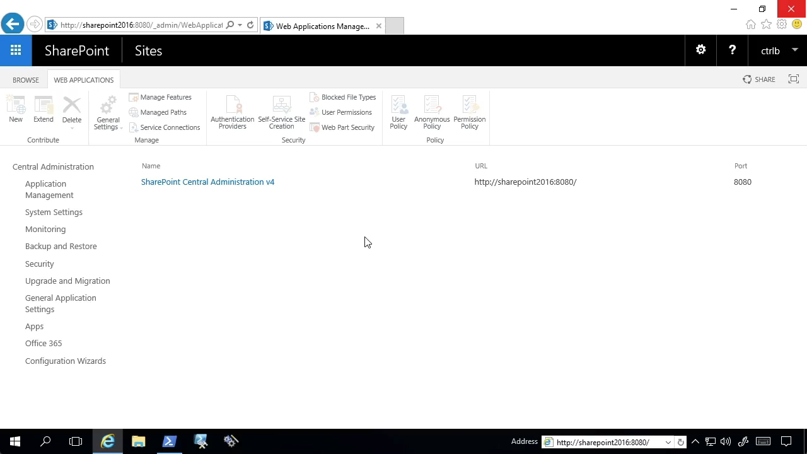
The Most Common Migration

Slide 26
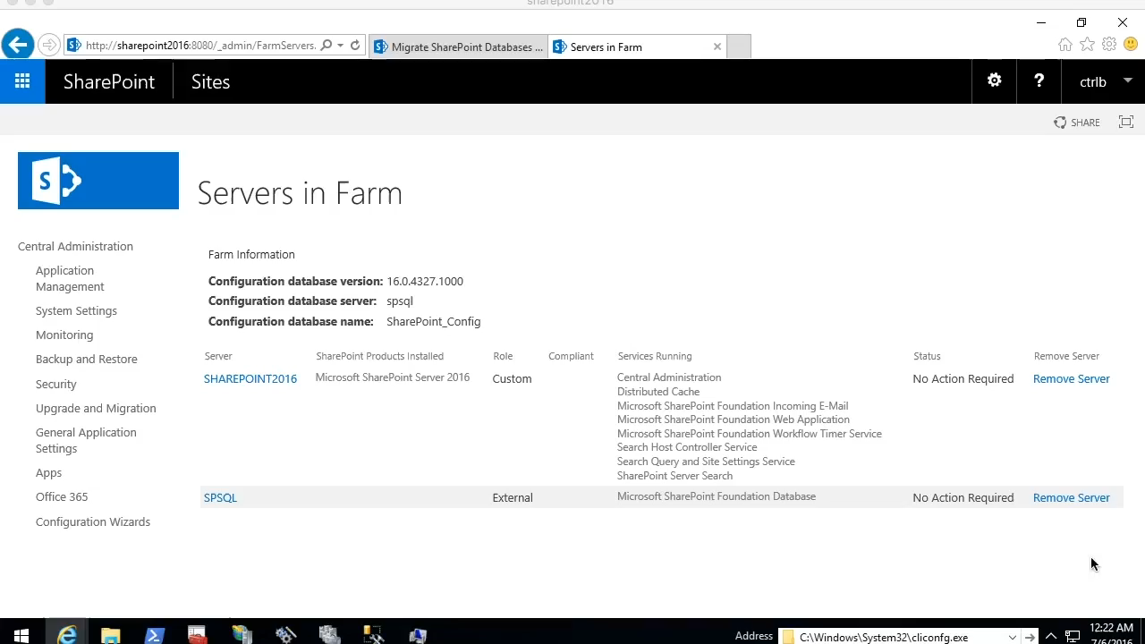
The Ideal Migration

Slide 27
Summary

Slide 28
Summary
PowerShell is awesome!

